Slide 1
Religious Recognitions for Lutherans
National Lutheran Association on Scouting
https://www.nlas.org
This presentation is available at
Notes:
Prepared by Wayne Stuckey,
National Lutheran Association on Scouting
wstuckey.nlas@gmail.com
03/13/2026

Slide 2
Religious Emblems Programs
Over 40 faith-specific groups participate in Religious Emblems Programs
Developed and administered by the participating faith groups
Encourage youth to grow stronger in their faith
Taught by the faith group clergy or appointed lay person
They are owned by the church
Notes:
Scouting America’s Duty to God brochure states, “The religious emblems programs are programs (youth faith-specific religious educational courses and adult recognition) created by the various religious groups (faith-specific) to encourage youth to grow stronger in their faith. ... The Boy Scouts of America [Scouting America] has approved of these programs and allows the recognition to be worn on the official uniform, but each religious organization develops and administers its own program. ... The religious emblems programs should be presented to youth members and their families … through their faith-based organization. Religious instruction should always come from these organizations, not from the unit leader.” The Religious Emblems Programs is a resource Scout Leaders can and should use to help youth to understand their duty to God. Scouts involved in the religious emblems program of their faith tend to remain in Scouting longer and achieve higher rank advancement.
Note: The Duty to God brochure is undergoing revisions; the most recent revision is presented here -> https://www.praypub.org/Data/Sites/1/media/resource-library/promotional-resources/duty-to-god-brochure-2022.pdf

Slide 3
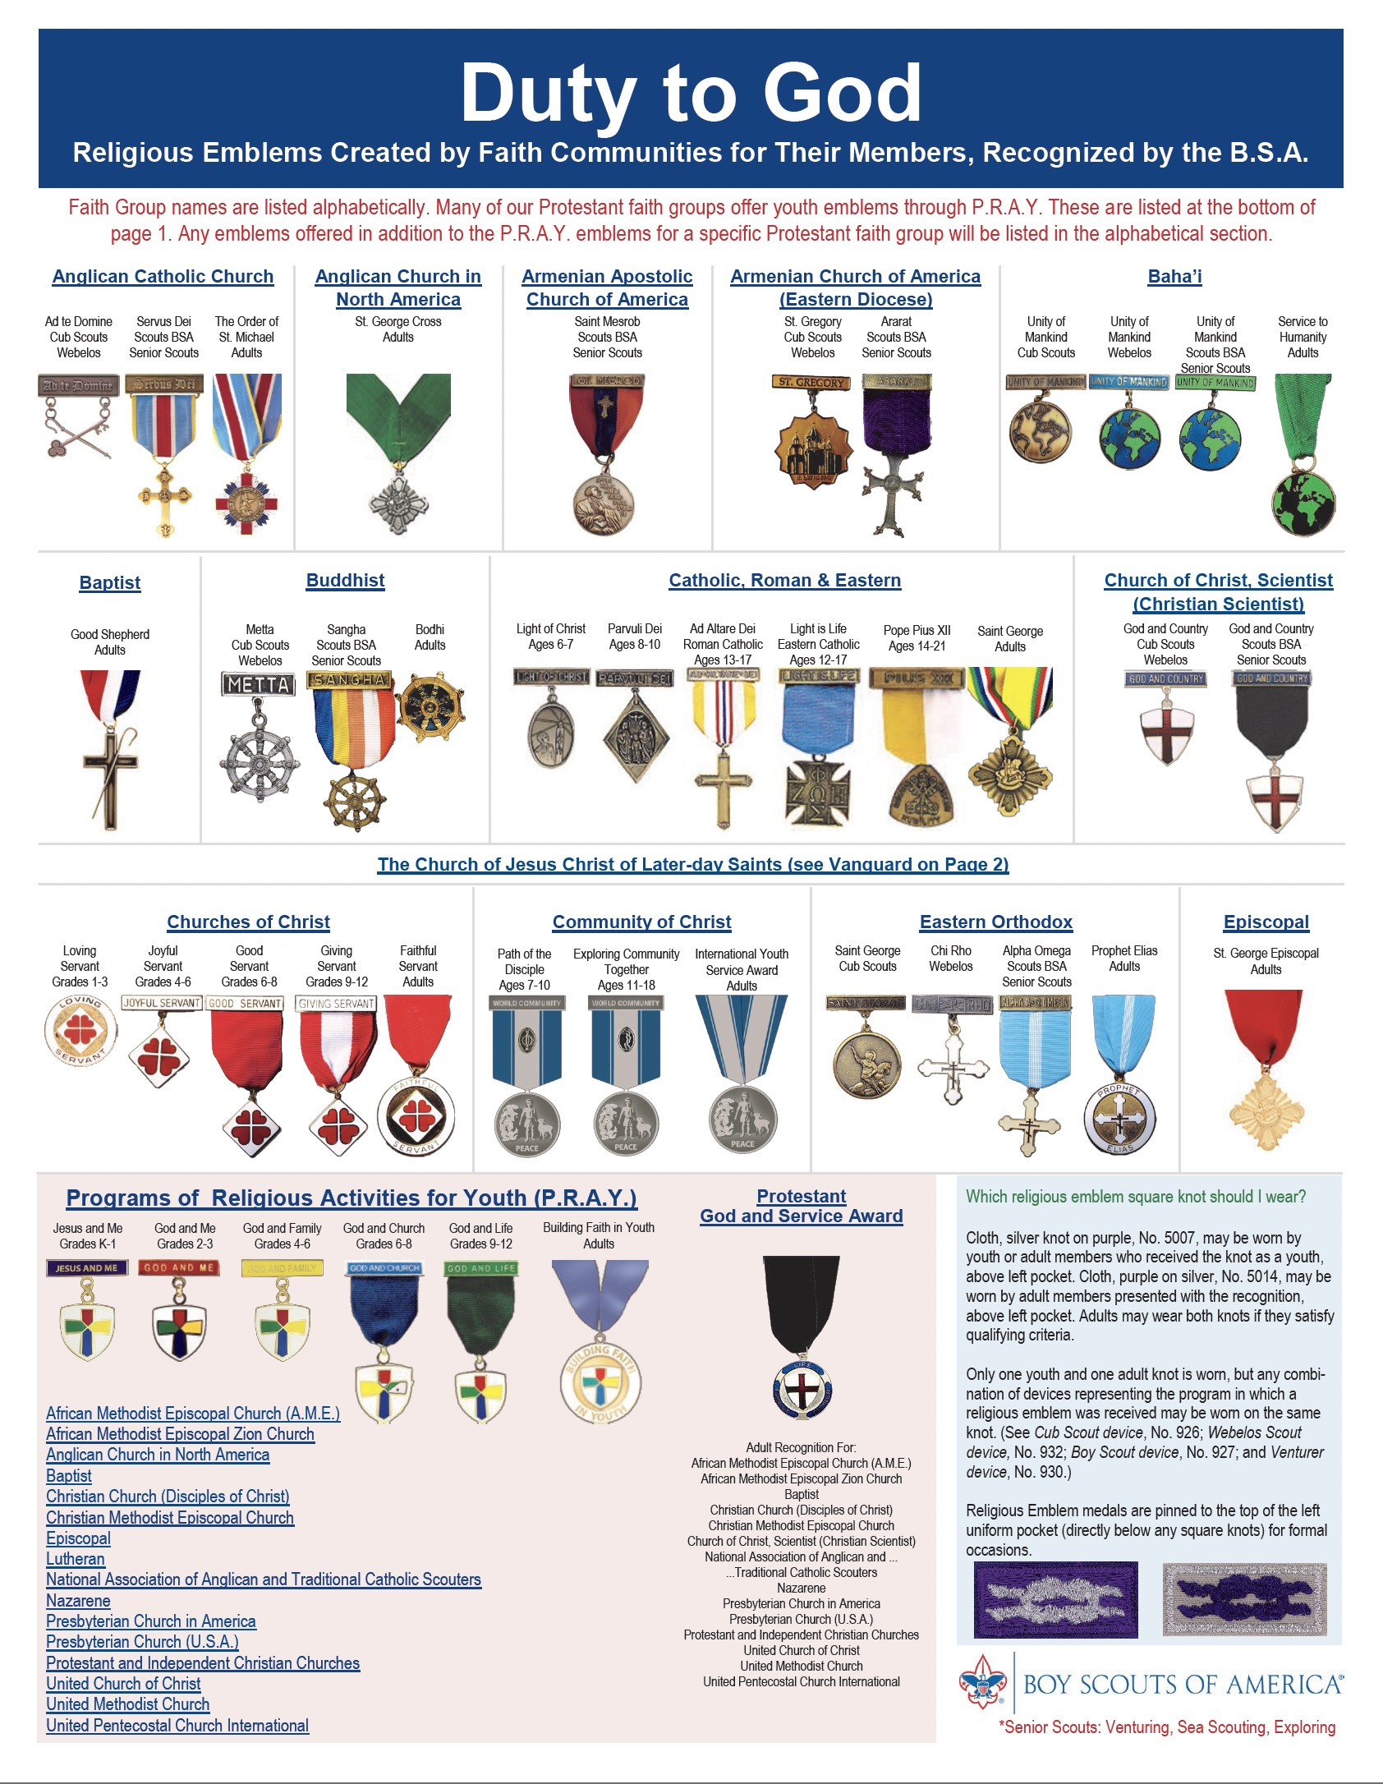
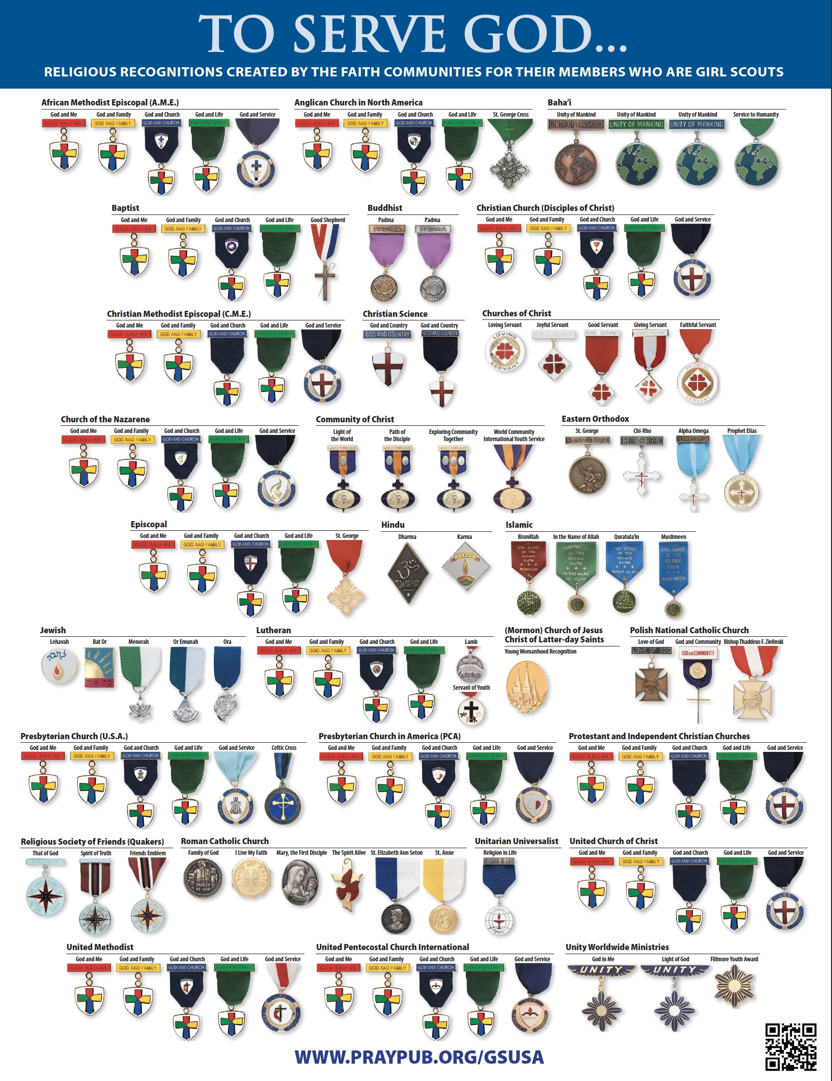
The Religious Emblems Programs are encouraged by
Scouting America
Girl Scouts of the USA
But they can be earned by all Lutheran Youth
Siblings & friends
Sunday School
Confirmation
Notes:
Clickable Religious Emblems program chart for Scouting America, in either 8.5” x 11” or 11” x 17” size, is available at https://dutytogodbsa.org/portfolio/religious-emblems-brochure/
Girls in GSUSA may consider earning the My Promise, My Faith pin in combination with the religious recognitions https://my.girlscouts.org/content/dam/gssn/images/Faith_Handout_EnglishDescription.pdf

Slide 4


Religious Emblems Programs
The Lutheran Religious Emblems are owned and approved by
The Lutheran Church – Missouri Synod
Evangelical Lutheran Church in America
The Lutheran Churches use the Religious Emblems used by many Protestant & Independent Churches through the Programs of Religious Activities with Youth (P.R.A.Y.)

Slide 5
How do the Religious Emblems become Lutheran
if they are used by many Protestant and Independent Churches?
The Lutheran Churches collaborated on and approved them
Taught by a Lutheran pastor or a trusted lay person
Substantial interaction with the youth’s family and their pastor*
Increasing interaction with the youth’s pastor* with age
Each recognition is reviewed and approved by the youth’s pastor*
*provision can be made for youth who do not have a family pastor
Notes:
*provision can be made for youth who do not have a family pastor

Slide 6
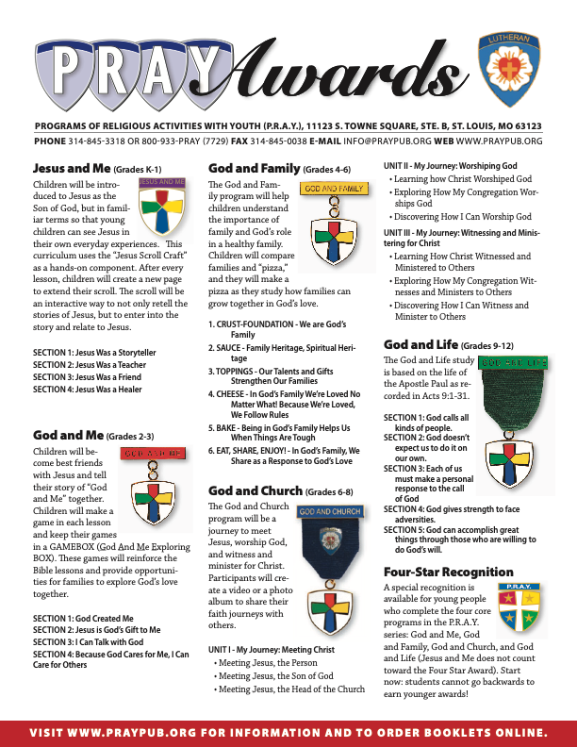
What are the Lutheran Recognitions?
Notes:
The Lutheran Awards brochure is available at https://www.praypub.org/Data/Sites/1/media/denomination-resources/lutheran/pray-lutheran-brochure.pdf
Search by Faith to find contact info for Religious Emblems of other faith groups https://www.praypub.org/religious-emblems

Slide 7
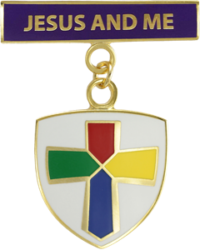
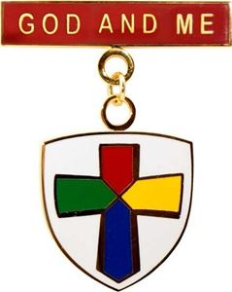
What are the Lutheran Recognitions?
 | Jesus and Me (Grades K-1) Jesus and Me introduces Jesus as the Son of God in a way that young children can see Jesus in their everyday experiences as a storyteller, teacher, friend, and healer. A hands-on “Jesus Scroll Craft” helps children tell their story of Jesus and Me. Recognizing that parents and guardians are responsible for the faith development of their children, Jesus and Me requires their participation and encourages parent-child interaction.
 | God and Me (Grades 2-3) Children will become best friends with Jesus and tell their story of “God and Me” together. Children will make a game in each lesson and keep their games in a GAMEbox (God And Me Exploring box). The games reinforce the Bible lessons and provide opportunities for families to explore God’s love together.
Notes:
P.R.A.Y. Program description - https://www.praypub.org/pray

Slide 8
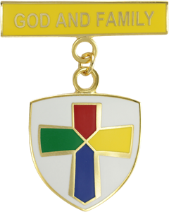
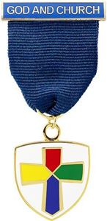
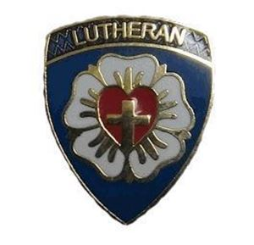
What are the Lutheran Recognitions?
 | God and Family (Grades 4-6) God and Family helps youth to understand the importance of family and God’s role in a healthy family. Children build a “pizza” as they study how families can grow together in God’s love and build their understanding of God’s love for their families. They choose “family projects” to be done together with their family at home.
 | God and Church (Grades 6-8) God and Church leads youth on a three-part faith journey of: meeting Jesus, worshiping God, witnessing and ministering for Christ. They make a plan for daily Bible reading and memorize a creed or statement of belief or passage of scripture. They create a video or a photo album to share what they have learned on their faith journeys. Young people have the opportunity to work with their pastor or other Christian adult to study the church's structures and objectives, participate in service projects, and strengthen their relationship with Christ.
Notes:
An optional pin for the youth’s specific denomination can be worn on the ribbon of the God and Church emblem. This is purchased from the P.R.A.Y. web store: https://store.praypub.org/god-church-lutheran-pin

Slide 9
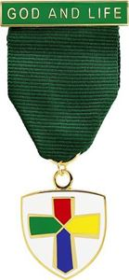
What are the Lutheran Recognitions?
 | God and Life (Grades 9-12) God and Life helps youth understand their call to a life of discipleship. God and Life focuses on the life of the Apostle Paul as recorded in Acts 9:1-31, that describes how Paul encountered Christ and was changed forever. Youth plan for daily Bible reading, experience the joy of serving others, write a statement of commitment, and explore what it means to live one's life for Christ. They have the opportunity to interview their pastor on his/her life decision to pursue an occupation of ministry.
Notes:
PRAY Program description - https://www.praypub.org/pray

Slide 10

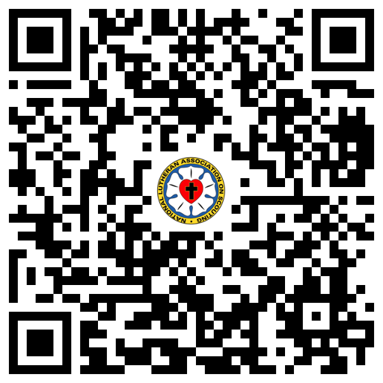
Additional Faith Recognitions
 | P.R.A.Y. Four-Star Recognition The P.R.A.Y. Four-Star Recognition is an award available from P.R.A.Y. for young people who complete the four core programs in the P.R.A.Y. series – God and Me, God and Family, God and Church, God and Life. The program recognitions must be earned in order because students cannot go backwards to earn younger religious emblems.
 | NLAS Four-Star Scholarship The NLAS Four-Star Scholarship is a competitive scholarship that is open to all youth registered with Scouting America or Girl Scouts of the USA who have successfully earned four (4) P.R.A.Y. Program recognitions and are seniors in High School. Two (2) $500 Scholarships are available annually and are paid directly on the student’s behalf to the designated institution for post-secondary education.
Notes:
P.R.A.Y. Four-Star Award – https://www.praypub.org/four-star-award
NLAS Four-Star Scholarship – https://nlas.org/wp-content/uploads/2026/03/NLAS-4-Star-Scholarship-application_r2026.pdf

Slide 11

Additional Faith Recognitions
 | NLAS Lutheran Recognition of Excellence The Lutheran Recognition of Excellence is awarded by NLAS to recognize outstanding scouting units that are chartered by Lutheran congregations or other Lutheran organizations and have met the criteria established by the National Lutheran Association on Scouting (such as completion of the appropriate Religious Emblems Program for their age level and religious affiliation, participation in the local Lutheran congregation Scout Sunday observance, completion of at least one service project for the chartering Lutheran organization, and participation in worship opportunities while away from their home congregations on Sundays). All members of the unit are authorized to wear the LRE patch. The LRE is awarded by application from Scouting America or GS-USA units.
Notes:
LRE application for Scouting America – https://nlas.org/wp-content/uploads/2025/10/SA-LRE-app-2025_fillable.pdf
LRE application for GS-USA – https://nlas.org/wp-content/uploads/2025/10/GS-LRE-app-2025_fillable.pdf

Slide 12

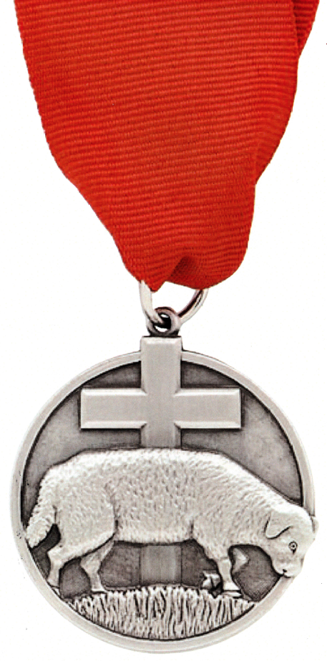
Adult Recognitions
 | Servant of Youth The Servant of Youth Award is bestowed by NLAS to recognize distinguished volunteer service to young people through one or more civic youth agency programs (such as Scouting America, GS-USA, AHG, Campfire and 4-H). The award is by nomination. The nominee should be an active member of a Lutheran congregation OR be an active member of another Christian congregation who has a minimum of 5 years of service to the church and to Lutheran young people through a civic youth agency affiliated with a Lutheran congregation.
 | Lutheran Lamb The Lamb Award is bestowed through NLAS on behalf of the youth ministry departments of the national Lutheran Churches. The purpose of the Lamb Award is to acknowledge the distinguished service of Lutheran adults in fostering the spiritual growth of youth through church and civic youth serving programs (such as Scouting America, GS-USA, AHG, Campfire and 4-H). The award is by nomination. The person must be an active member of a Lutheran congregation and have a minimum of 10 years of distinguished volunteer service to the church and to one or more of the civic youth agencies.
Notes:
The Servant of Youth application is available at https://www.praypub.org/documents-resources -> Lutheran Servant of Youth
The Lamb Award application is available at https://www.praypub.org/documents-resources -> Lutheran Lamb

Slide 13

Additional Adult Recognitions
 | P.R.A.Y. Building Faith in Youth Award The Building Faith in Youth Award is designed for Protestant congregations to recognize individuals who have contributed significantly to the youth ministries of their church through the P.R.A.Y. programs (God and Me, God and Family, God and Church, and God and Life). The award is by nomination from a Protestant congregation. The nominee must demonstrate exceptional Christian character and be active in a Protestant congregation, use the P.R.A.Y. programs to disciple young people and their families and to support the Christian Education program of the local Protestant congregation, and have a record of using and supporting a P.R.A.Y. ministry with a minimum tenure of three years.
Notes:
The Building Faith in Youth application is available at https://www.praypub.org/documents-resources -> Building Faith in Youth Award

Slide 14
Resources
PRAY Program description – https://www.praypub.org/pray
P.R.A.Y. resources for Scouting America – https://www.praypub.org/scouting-america
P.R.A.Y. resources for Girl Scouts – https://www.praypub.org/gsusa
Scouting America resources for Religious Emblems –
https://dutytogodbsa.org/portfolio/religious-emblems-brochure/
GS-USA resources for Religious Recognitions – https://www.girlscouts.org/content/dam/girlscouts-gsusa/forms-and-documents/about-girl-scouts/gs-and-faith/PRAY_Chart.pdf
P.R.A.Y. virtual Religious Emblems programs – https://www.praypub.org/virtual-programs
P.R.A.Y. Four-Star Award – https://www.praypub.org/four-star-award
NLAS Four-Star Scholarship – https://nlas.org/wp-content/uploads/2026/03/NLAS-4-Star-Scholarship-application_r2026.pdf
Notes:
Updated 03/13/2026

Slide 15
Resources
LRE application for Scouting America – https://nlas.org/wp-content/uploads/2025/10/SA-LRE-app-2025_fillable.pdf
LRE application for GS-USA – https://nlas.org/wp-content/uploads/2025/10/GS-LRE-app-2025_fillable.pdf
Servant of Youth application – https://www.praypub.org/documents-resources -> Lutheran Servant of Youth
Lamb Award application – https://www.praypub.org/documents-resources -> Lutheran Lamb
Building Faith in Youth application – https://www.praypub.org/documents-resources -> Building Faith in Youth Award
Lutheran Awards Brochure – https://www.praypub.org/Data/Sites/1/media/denomination-resources/lutheran/pray-lutheran-brochure.pdf
Search by Faith for Religious Emblems of other faith groups – https://www.praypub.org/religious-emblems -> Search by Faith
NLAS membership application – https://nlas.org/wp-content/uploads/2025/10/NLAS-Application-2025_fillable.pdf
Notes:
Updated 03/13/2026

Slide 16
Who is NLAS?
NLAS was formed to assist the offices of youth ministry of The Lutheran Church-Missouri Synod and the churches that became the Evangelical Lutheran Church in America in relation to civic youth-serving agencies such as Scouting America, Girl Scouts of the USA, Campfire USA and 4-H.
NLAS is a national association of volunteer members that operates in partnership with the offices of youth ministry of the ELCA and LCMS to encourage Lutheran congregations, schools and other organizations to extend their ministry to children, youth, and families using the programs of these civic youth-serving agencies, and advocates emphasis on duty to God and encouraging growth of faith in youth in the programs of our youth-serving partners.
https://www.nlas.org

